Slide 1
Getting Started

Slide 2
Objectives
What is computer vision?
Where are the computer vision apply to?
What are the challenges of computer vision?
The future of computer vision?

Slide 3
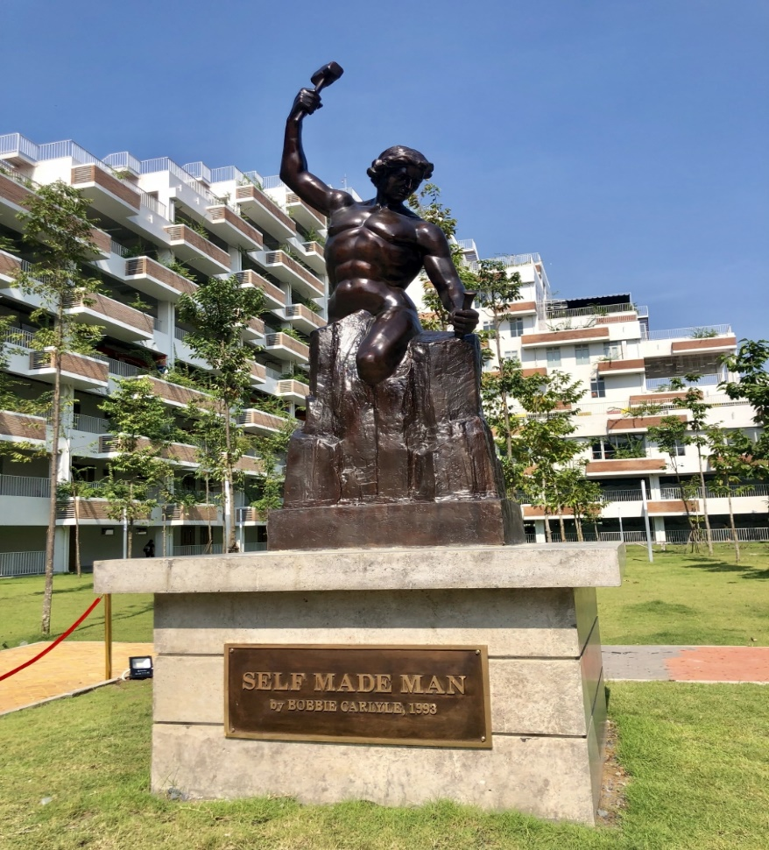
What is computer vision
Computer Vision is a field of computer science that enables the computer to understand just like a human.
What are objects in the image?
How many trees are there in the picture?
What color is the sky?

Slide 4
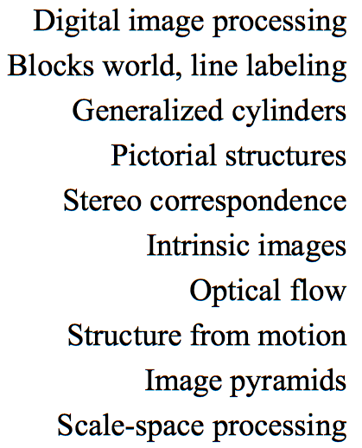
History of computer vision
1970
1975
1980

Slide 5
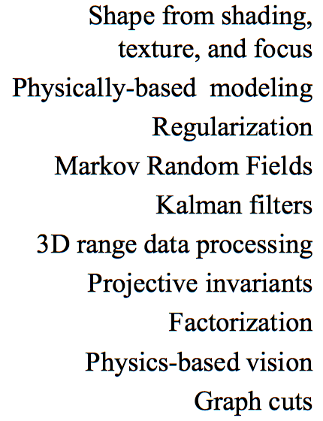
History of computer vision
1980
1985
1990

Slide 6
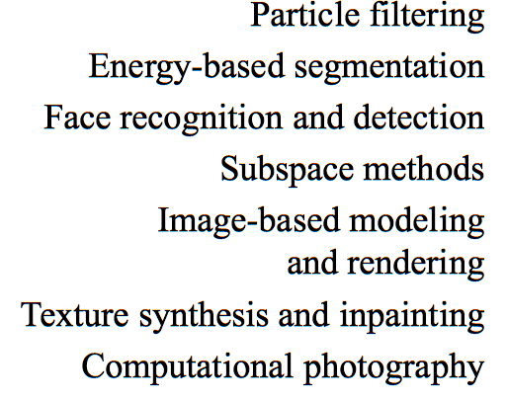
History of computer vision
1990
1995
2000

Slide 7
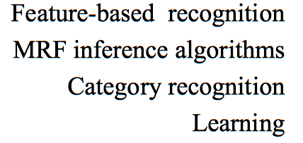
History of computer vision
2000
2005

Slide 8
The related fields
Image processing
Information retrieval
Robotics
Computer Vision
Machine learning
Cognitive sciences
Graphics, algorithms
Neurobiology

Slide 9
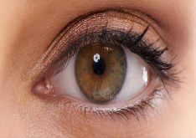

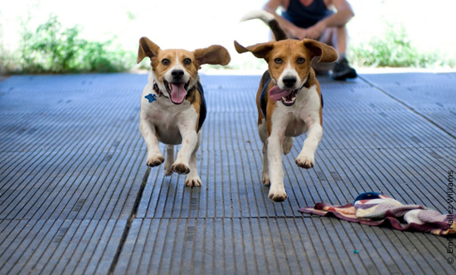
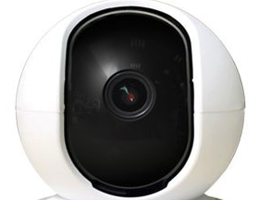
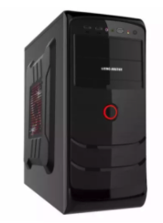
The Vision: Human & Computer
Human, dog, happy, run, etc
Sensing
Interpreting

Slide 10
The Human Vision
Human, dog, happy, run, etc
Sensing
Interpreting
Loss memory
Dependency
Huge data→ slow
Notes:
Interpretations
Interpretations

Slide 11
The Computer Vision
Transfer learning
Fair
Huge data→ Fast
Human, dog, happy, run, etc
Sensing
Interpreting
Notes:
Interpretations
Interpretations

Slide 12
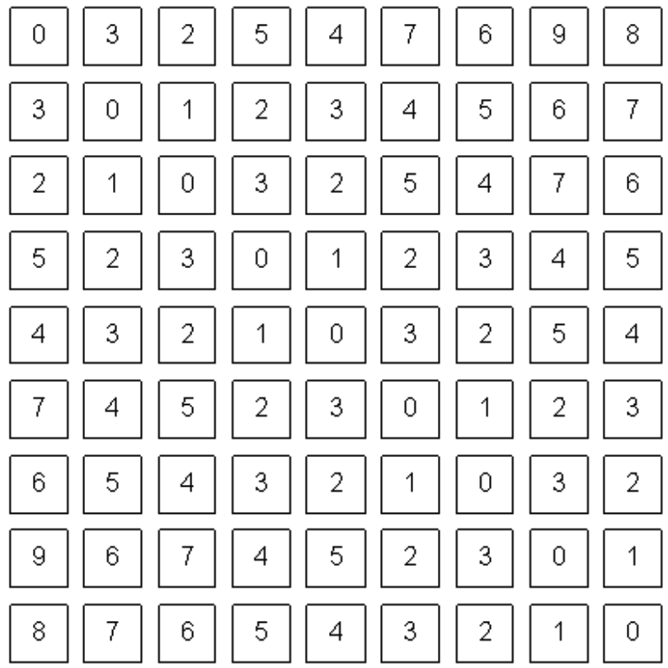
The goal of computer vision
Perceive the “story” behind the picture
You see
Computer see

Slide 13
How Does Computer Vision Work?
Computer vision is a more high-level process of image processing- analysis of an image.
The input is an image while the output is the interpretation of an image.
Computer vision works by identifying different components in the image.

Slide 14
The computer vs human perception
Computer likes human
Computers can be better at “easy” things
Humans are much better at “hard” things
But huge progress has been made
Accelerating in the last 4 years due to deep learning
What is considered “hard” keeps changing
Notes:
Interpretations
Interpretations

Slide 15
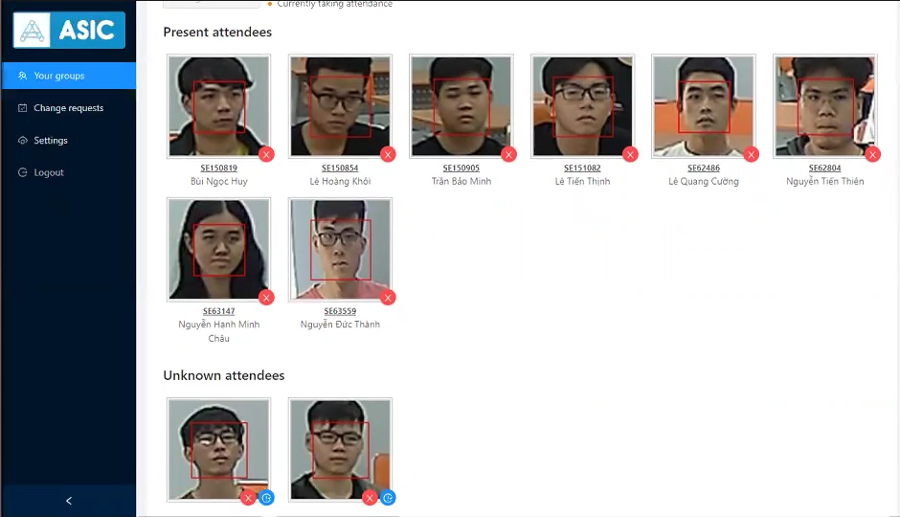
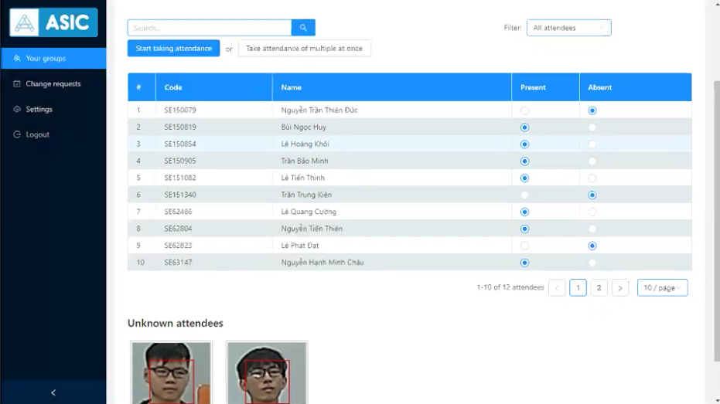
Application in Facial Recognition
Notes:
Interpretations
Interpretations

Slide 16
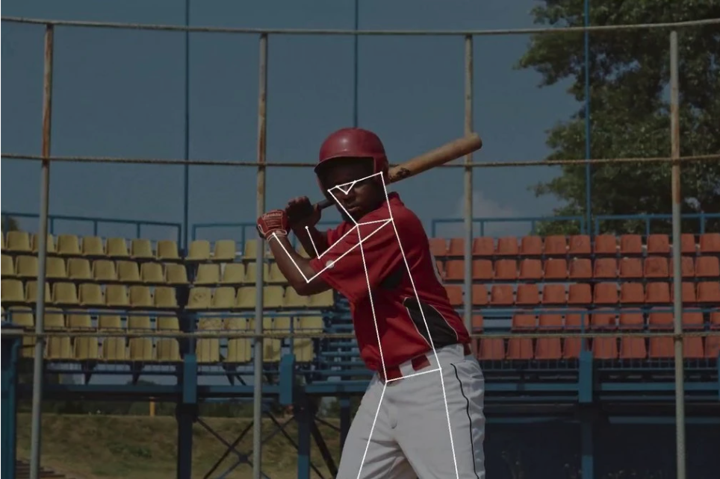
Application in life
Stroke Recognition
Near Real-Time Coaching
Sports Team Behaviors Analysis
Automated Media Coverage
Ball Tracking
Goal-Line Technology
Event Detection in Sports
Sports Activity Scoring
Player Pose Tracking

Slide 17
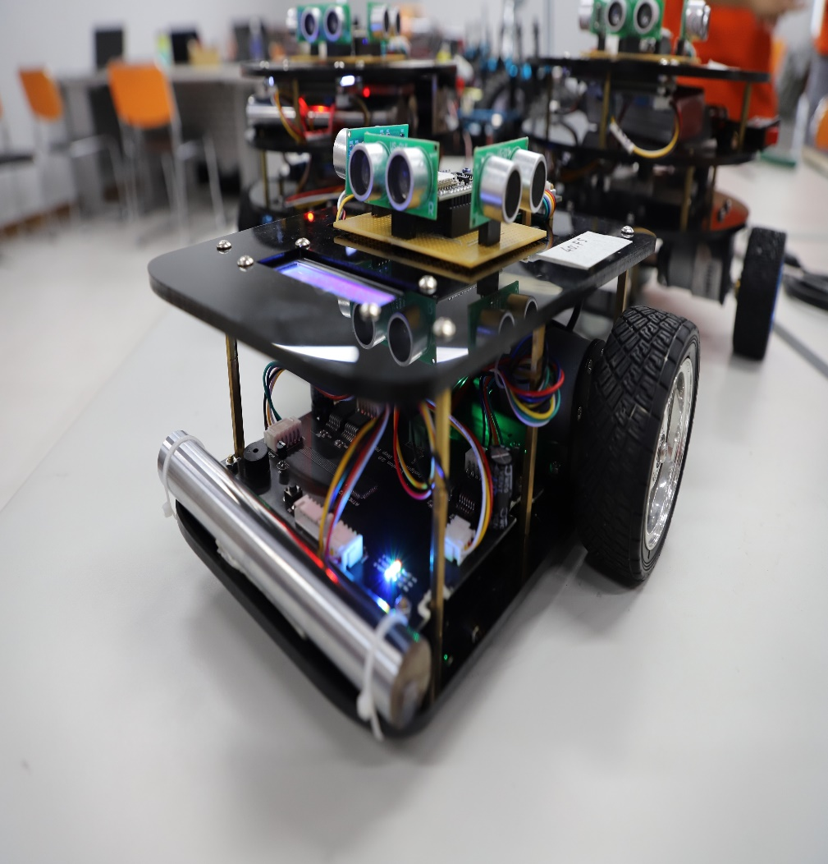
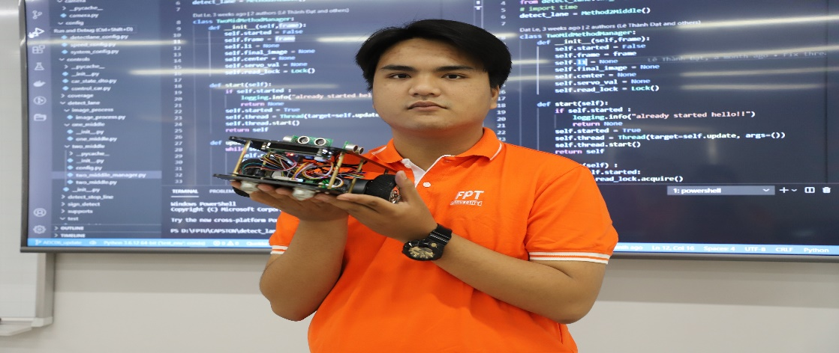
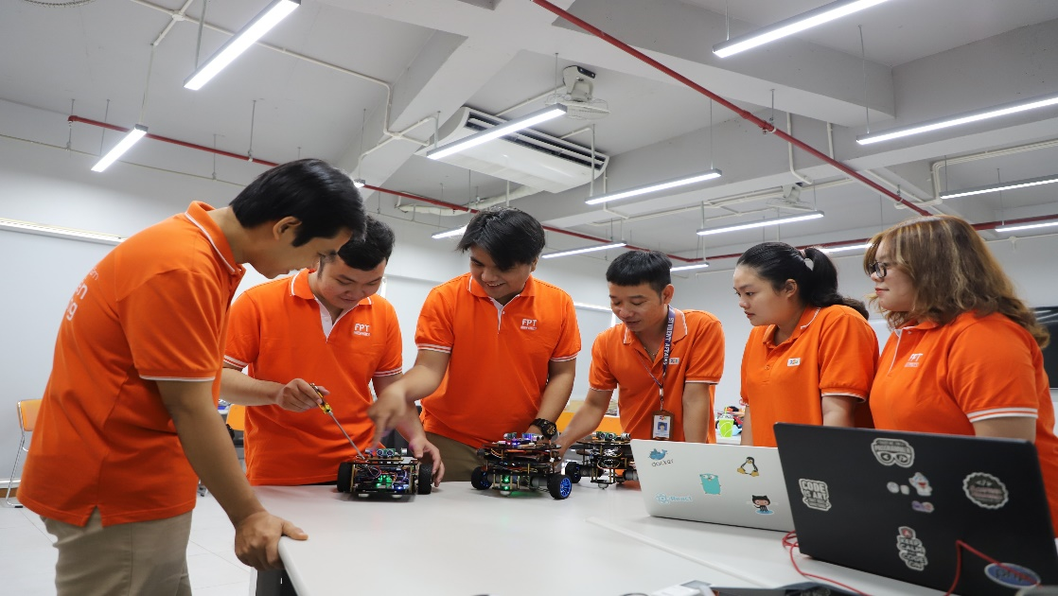
Application in Robotics
Notes:
Interpretations
Interpretations

Slide 18
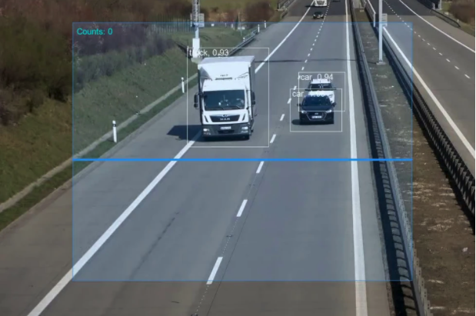
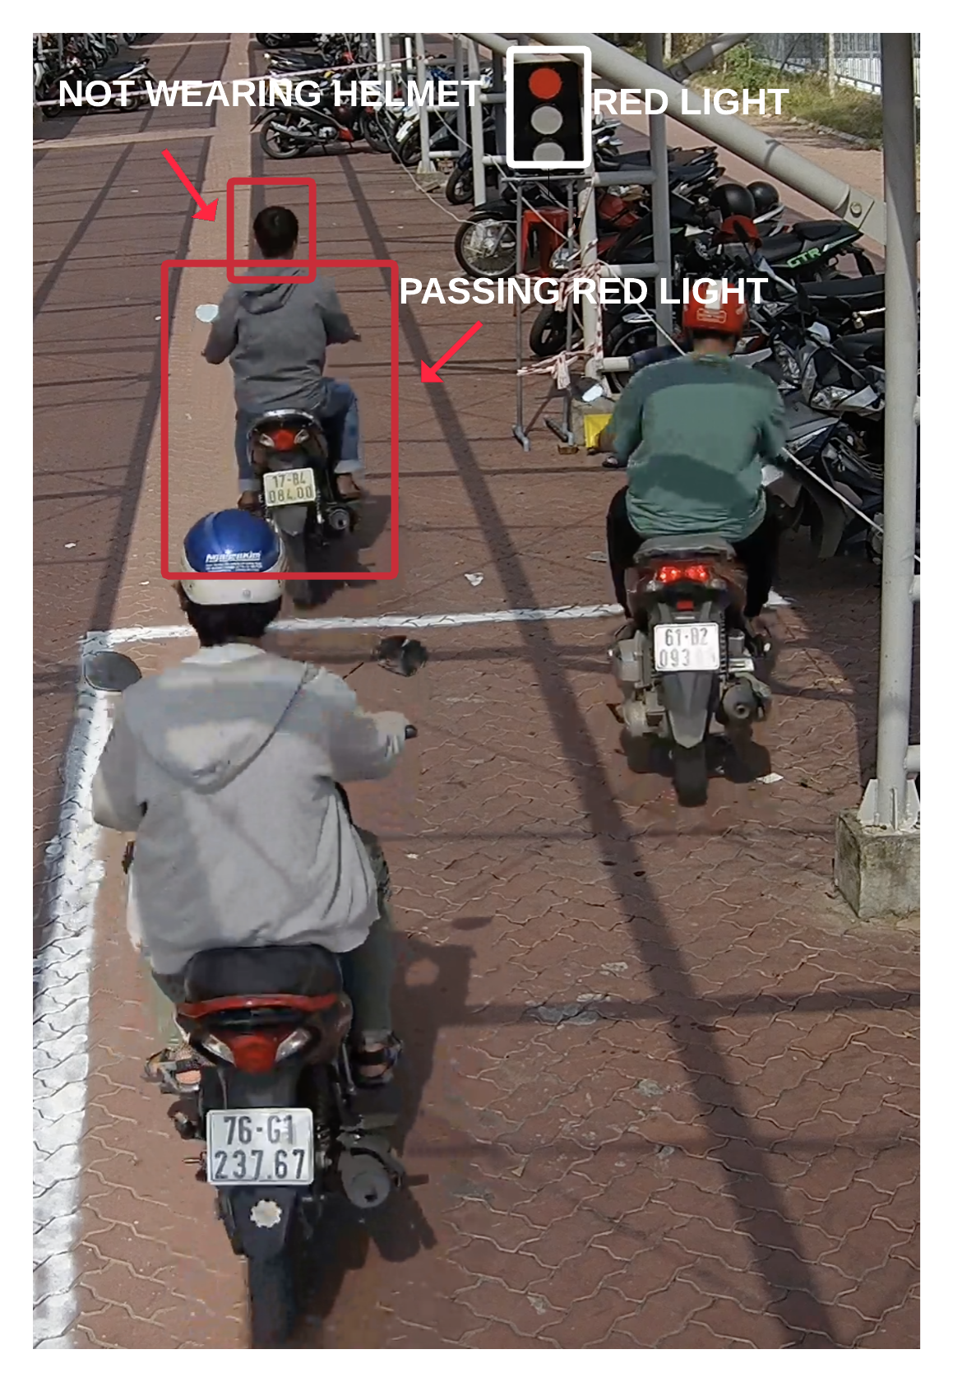
Application in Transportation
Vehicle Classification
Moving Violations Detection
Traffic Flow Analysis
Parking Occupancy Detection
Automated License Plate Recognition
Vehicle identification
Traffic Sign Detection
Road Condition Monitoring
Driver Attentiveness Detection
Notes:
Interpretations
Interpretations

Slide 19


Application in Retail and Manufacturing
Customer Tracking
People Counting
Theft Detection
Waiting Time Analytics
Social Distance
Productivity Analytics
Quality Management

Slide 20
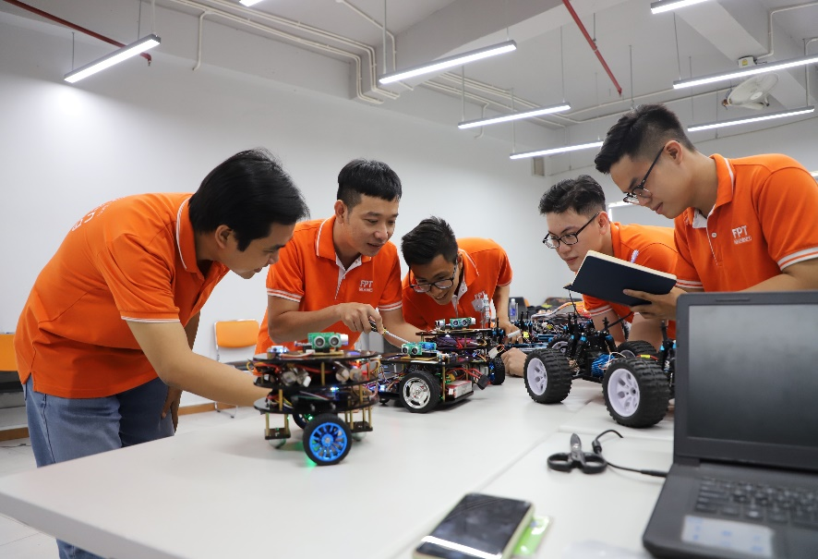
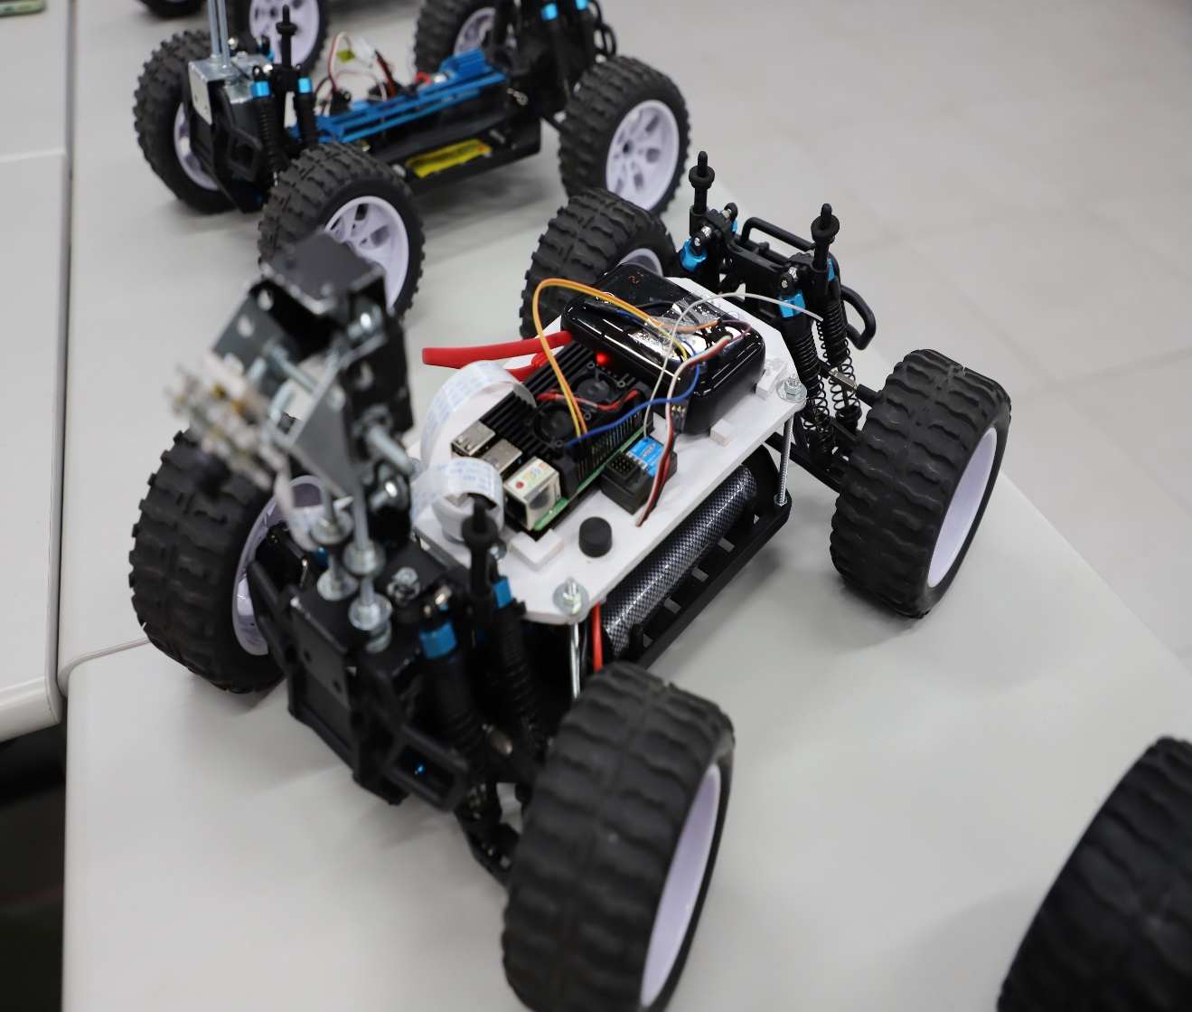
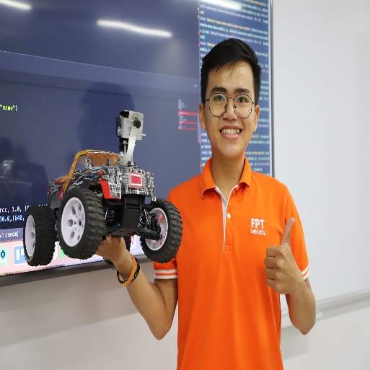
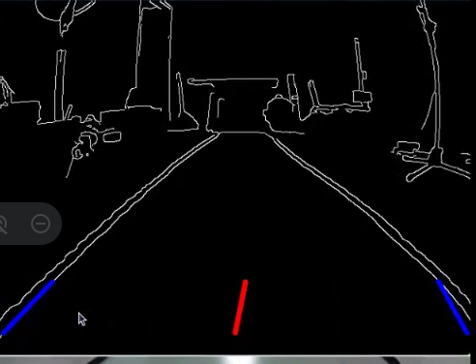
Application in Self-driving cars
Notes:
Interpretations
Interpretations

Slide 21
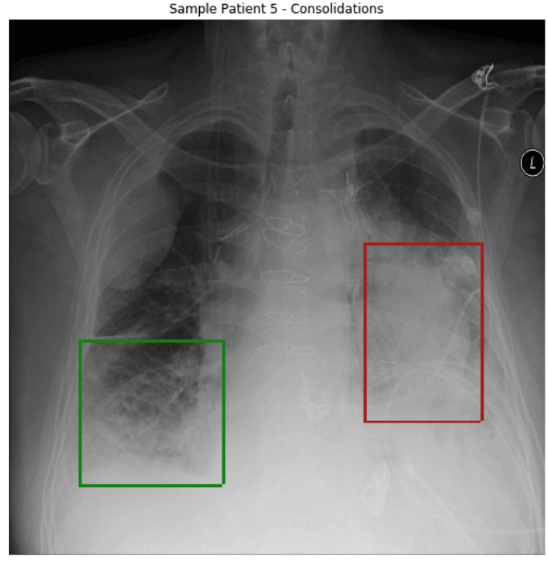
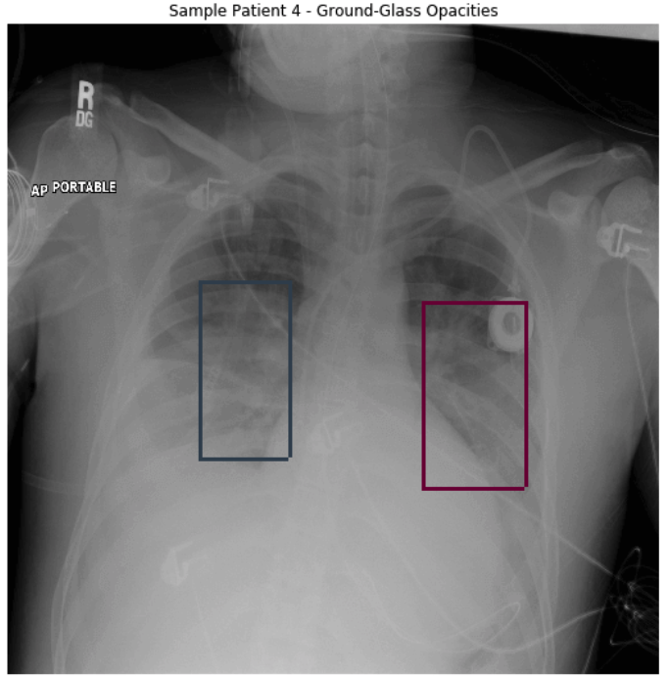
Application in Medical
Cancer Detection
Cell Classification
Movement Analysis
Mask Detection
Tumor Detection
Disease Progression Score

Slide 22
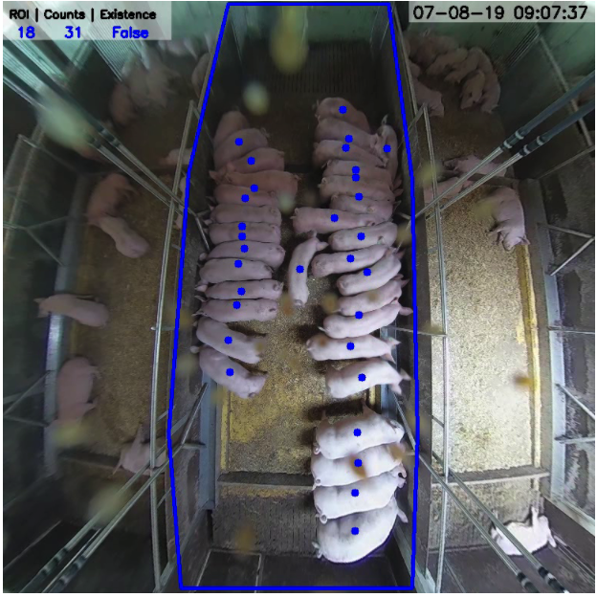
Application in Agriculture
Crop Monitoring
Flowering Detection
Plantation monitoring
Insect Detection
Plant Disease Detection
Automatic weeding
UAV Farmland Monitoring
Animal Monitoring

Slide 23
Challenges of Computer Vision
Computer vision is a challenging field of computer science.
Enabling a machine to be able to see, and process what it sees, like a human → difficult.
We are still learning exactly how human vision works
Scene reconstruction- the creation of a 3D model
The inputting of 2D images or video, are also problematic.

Slide 24
Challenges of Computer Vision
Recognition must become robust
Depend on object classification, identification, verification and detection
Depend on identify the key points or landmarks in a picture
Object segmentation, identifying the pixels in an image
Once recognition is achieved CV systems must also correctly analyze the image.
If applied to a video, this requires accurate motion analysis.
This allows the system to estimate the velocity of objects in the video.

Slide 25
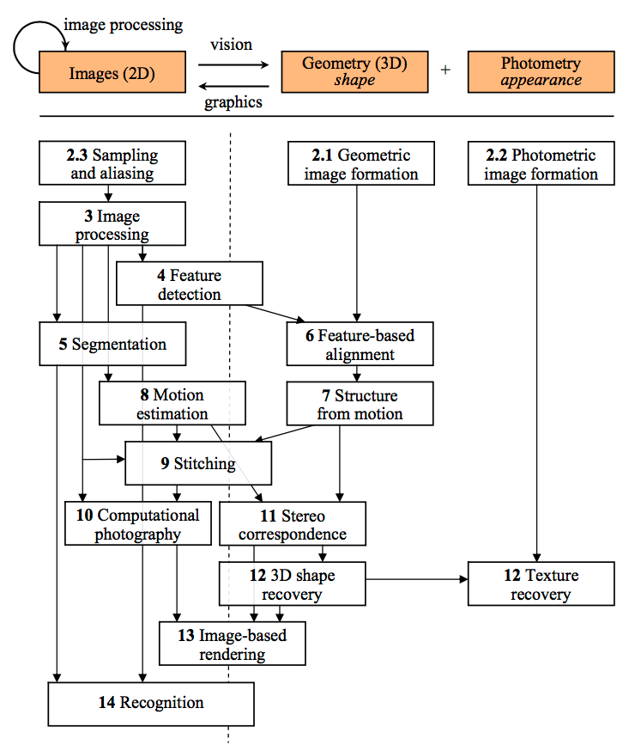
Relationship between images, geometry, and photometry
Notes:
Relationship between images, geometry, and photometry, as well as a taxonomy

Slide 26
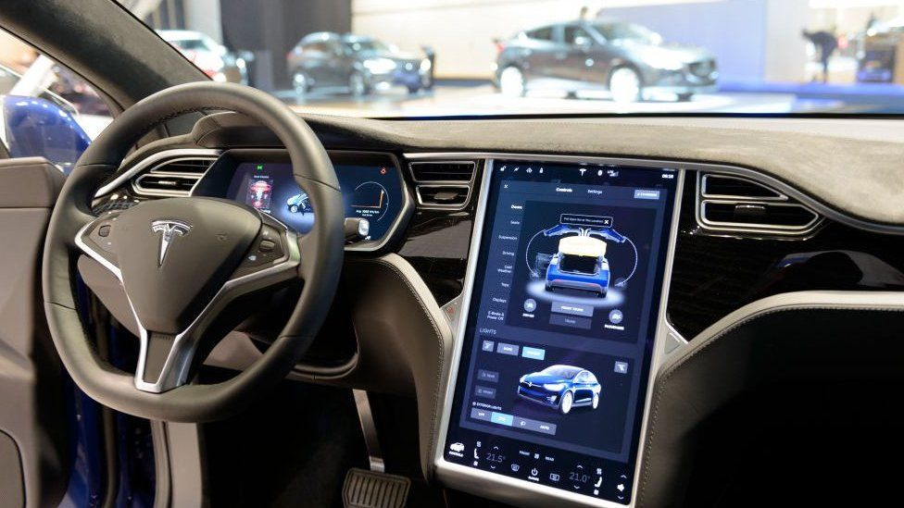
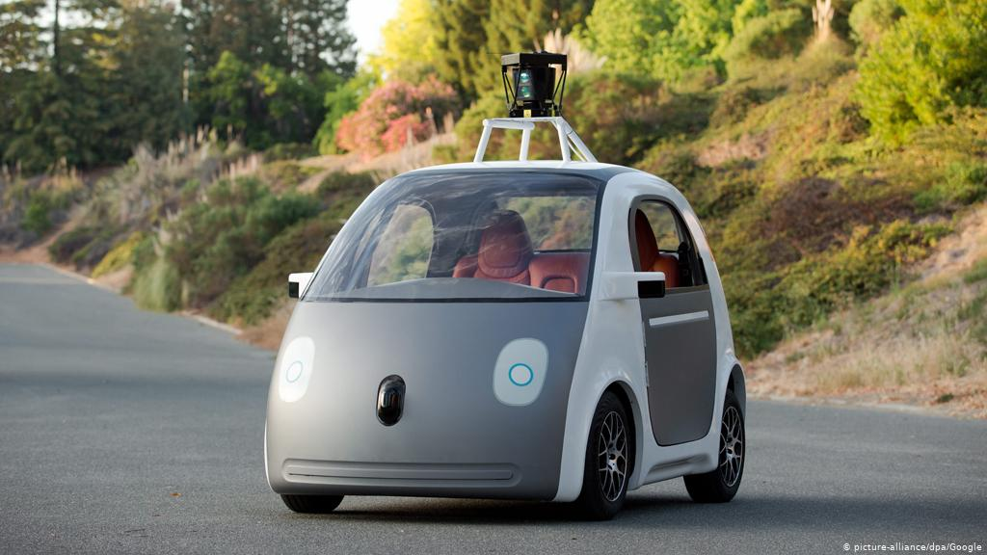
The future of computer vision
Computer vision, as well as AI and machine learning concepts, are key to releasing complete, or Level 5, automation in self-driving vehicles.

Slide 27
Summary
What is computer vision?
Where are the computer vision apply for?
What are the Challenges of Computer Vision?
The future of computer vision?

